Slide 1

Sentiment Analysis & Topic Modeling Mobile Application (SentiScope)
Project members:
Avanish Jha CB.EN.U4ELC20011
Ratneshwar Bharti CB.EN.U4ELC20056
Ravi Gupta CB.EN.U4ELC20057
Rudraksh Singh CB.EN.U4ELC20060
Guided by:
Mr. R Ranjith
Associate Professor
EEE Dept.

Slide 2
Significance
Data-Driven Decisions: Real-time sentiment insights guide businesses.
Customer Engagement: Address sentiments for better loyalty.
Crisis Prevention: Detect negative trends early.
Tech Integration: Showcasing the synergy of Flutter, Firebase, and ML.

Slide 3
Objective
To understand the demand for sentiment analysis tools.
To identify gaps in current market offerings.
To design a user-friendly interface with Flutter.
To integrate Firebase for backend operations.
To implement ML models for sentiment analysis.

Slide 4
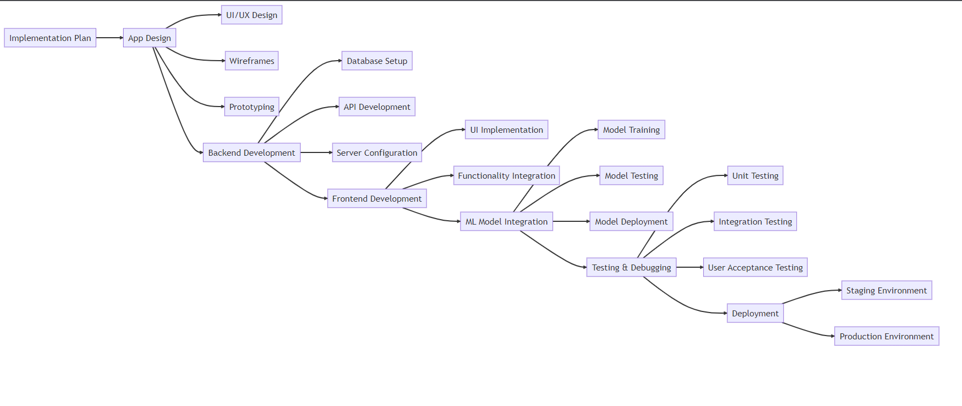
Project Block Diagram

Slide 5
Methodology
1. Preliminary Research:
- Study existing sentiment analysis and topic modeling tools.
- Identify strengths, weaknesses, and gaps in current market offerings.
2. System Design:
- Design the app's architecture, considering the integration of Flutter for frontend and
Firebase for backend operations.
- Plan the integration of ML models for sentiment analysis and topic modeling.
3. Model Selection and Training:
- Choose suitable ML models for sentiment analysis and topic modeling.
- Train the models using labeled datasets to ensure accuracy.
4. App Development:
- Develop the frontend using Flutter, ensuring a user-friendly interface.
- Set up the backend operations using Firebase, including data storage, user
authentication, and API integrations.
- Integrate the trained ML models into the app.

Slide 6
Time Frame
Month and Year | Task to be Completed
September 2023 | Literature survey
October 2023 | Design Phase
November 2023 | Backend Development
December 2023 | Frontend Development
January 2024 | ML Model Integration
February 2024 | Testing & Debugging
March 2024 | Deployment
April 2024 | Feedback & Iteration

Slide 7
References(IEEE Format)
[1] M. T. H. K. Tusar, and M. T. Islam, “A Comparative Study of Sentiment Analysis Using NLP and Different Machine Learning Techniques on US Airline Twitter Data”, ResearchGate. [Accessed: 18-Aug.-2023].
[2] P. Kherwa, and P. Bansal, “Topic Modeling: A Comprehensive Review”, ResearchGate. [Accessed: 16-Aug.-2023].
[3] Blei, D. M., Ng, A. Y., & Jordan, M. I. (2003). Latent Dirichlet Allocation. Journal of Machine Learning Research, 3, 993-1022. [Accessed: 16-Aug.-2023].
[4] S. R. Joseph, K. Sedimo, F. Kaniwa, and H. Hlomani, “Natural Language Processing: A Review”, ResearchGate. [Accessed: 16-Aug.-2023].
[5]“Flutter documentation”, Flutter. [Online]. Available: https://docs.flutter.dev/?gclid=Cj0KCQjwuZGnBhD1ARIsACxbAVjXhZ2qS5xvzEbnEq-ZRQZ0ikg_gZqxlA2XPOOUjuKbEZ5qFxYMNjAaAoTBEALw_wcB&gclsrc=aw.ds. [Accessed: 20-Aug.-2023].

